Slide 1

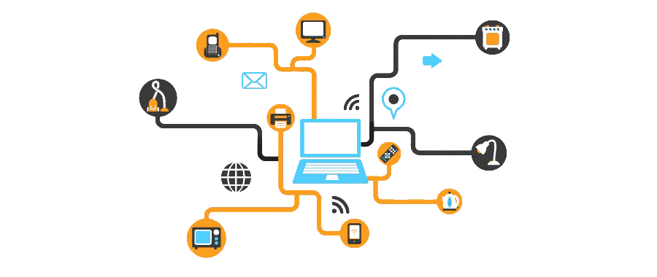

3130704
Digital Fundamentals
Module 4:
A/D and D/A Converters
Prof. Krunal D. Vyas
9601901005
krunal.vyas@darshan.ac.in

Slide 2
Topics to be covered
Digital to analog converters
Specifications for D/A converters
Sample and hold circuit
Analog to digital converters
Specifications for A/D converters
Example of D/A converter ICs and A/D converter ICs

Slide 3
Digital to analog converter
Converts straight binary or BCD code into a voltage or current which is proportional to the digital value.
Fig shows the symbol for a typical 4-bit D/A converter.
MSB
D
C
D/A
Converter
(DAC)
Digital
Inputs
V_{out}
B
Analog
output
A
LSB

Slide 4
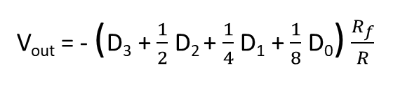
Weighted-resistor type DAC
R
(MSB)D₃
R_{f}
2R
I
D₂
_
I
V_{out} = - (D₃ + $\frac{1}{2}$ D₂ + $\frac{1}{4}$ D₁ + $\frac{1}{8}$ D₀) $\frac{R_{f}}{R}$
4R
+
D₁
8R
(LSB)D₀
The main disadvantage is that a different-valued precision resistor must be used for each bit position of the digital input.

Slide 5
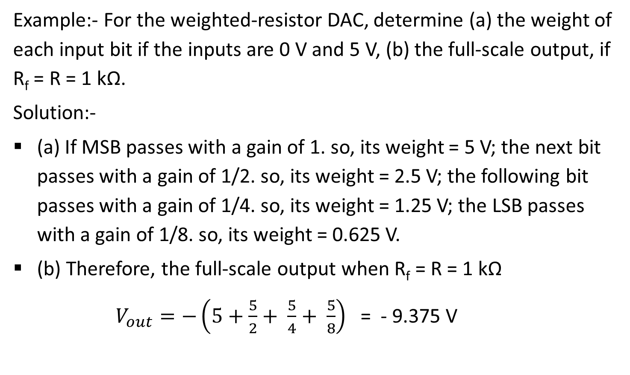
Weighted-resistor type DAC
Example:- For the weighted-resistor DAC, determine (a) the weight of each input bit if the inputs are 0 V and 5 V, (b) the full-scale output, if R_{f} = R = 1 kΩ.
Solution:-
(a) If MSB passes with a gain of 1. so, its weight = 5 V; the next bit passes with a gain of 1/2. so, its weight = 2.5 V; the following bit passes with a gain of 1/4. so, its weight = 1.25 V; the LSB passes with a gain of 1/8. so, its weight = 0.625 V.
(b) Therefore, the full-scale output when R_{f} = R = 1 kΩ
$V_{out}=−\left(5+\frac{5}{2}+ \frac{5}{4}+ \frac{5}{8}\right)$ = - 9.375 V

Slide 6
R-2R ladder type DAC
_
+
R
R
R
+
V_{out} = Analog output
2R
2R
2R
2R
2R
(LSB)D₀
D₁
D₂
(MSB)D₃

Slide 7
R-2R ladder type DAC
Case 1: Input is 1000
R
R
R
+
2R
2R
2R
2R
2R
V_{out}
D₀
D₁
D₂
D₃
+E
A
+
2R
2R
2R
V_{out}
E
V_{out} = E/2
2R
+E

Slide 8
R-2R ladder type DAC
Case 2: Input is 0100
B
R
A
+
2R
2R
2R
V_{out}
+E
2R
B
R
A
2R
E
i₁
E/2
V_{out} = E/4
2R
2R

Slide 9
R-2R ladder type DAC
Case 3: Input is 0010
C
R
B
R
A
+
2R
2R
2R
2R
V_{out}
+E
2R
C
R
B
R
A
2R
E
i₁
2R
i₂
2R
E/4
V_{out} = E/8
2R

Slide 10
R-2R ladder type DAC
Case 4: Input is 0001
2R
R
C
R
B
R
A
E
i₁
2R
i₂
2R
i₃
2R
2R
E/8
V_{out} = E/16
2R

Slide 11
Specifications for DAC
1) Resolution:-
Smallest change that can occur in an analog output as a result of a change in the digital input.
Equals to the weight of the LSB and also referred to as the step size.
Step size is the amount by which V_{out} will change as the digital input value is changed from one value to the next.
% resolution = step size / full scale x 100%
Full-scale = No. of steps x step size,
% resolution = 1 / No. of steps x 100%

Slide 12
Specifications for DAC
2) Accuracy:-
Specified in terms of full-scale error and linearity error
Full-scale error is the maximum deviation of DAC’s output from its expected value.
Linearity error is the maximum deviation of the analog output from the ideal output.

Slide 13
Specifications for DAC
3) Settling time:-
The time required for the analog output to settle to within ± ½ LSB of the final value after a change in the digital input.
It is because of the presence of switches, active devices, stray capacitance, and inductance.
4) Offset voltage:-
Ideally, the output of a DAC should be zero when the binary input is zero.
However, in practice, there is a very small output voltage under this situation called the offset voltage.

Slide 14
Specifications for DAC
5) Monotonicity:-
This means that the staircase output will have no downward steps as the binary input is incremented from 0 to full-scale value.
6) Temperature sensitivity:-
The analog output voltage for any fixed digital input varies with temperature.

Slide 15
Specifications for DAC
Example:- An 8-bit DAC produces V_{out} = 0.05 V for a digital input of 00000001. Find the full-scale output. What is the resolution? What is V_{out} for an input of 00101010?
Solution:-
Full-scale output = Step size x No. of steps
= 0.05 x (2⁸ – 1) = 0.05 x 255 = 12.75 V
% resolution = 1 / 255 x 100 %
= 0.392 %
V_{out} for an input of 00101010 = 42 x 0.05
= 2.10 V

Slide 16
Sample and hold circuit
S
V_{i}
V_{o}
Digitally
Controlled
switch
Basic Sample and hold circuit
V_{i}
_
_
V_{o}
Analog
input
+
+
S
DC
output
Clock
Practical Sample and hold circuit

Slide 17
Quantization and encoding
1 V
111
7/8 V
110
6/8 V
101
5/8 V
100
4/8 V
011
3/8 V
010
2/8 V
001
1/8 V
000
0 V

Slide 18
Parallel comparator A/D converter
8 V
E_{REF}
Analog input
3.7 V
R
+
_
L
7/8 E_{REF}
R
+
6/8 E_{REF}
_
L
R
+
D₂
5/8 E_{REF}
_
L
0
R
Priority
encoder
Digital
output
+
D₁
4/8 E_{REF}
_
L
1
R
D₀
+
_
H
1
3/8 E_{REF}
R
+
2/8 E_{REF}
_
H
R
+
_
H
1/8 E_{REF}
R

Slide 19
Successive approximation type ADC
10.3 V
Analog
input
V_{A}
LOW
CLK
+
HIGH
Control
logic
_
START
12 V
Comparator
EOC
11 V
10 V
8 V
Output
register
MSB
LSB
1011
Binary output
1100
1000
1010
DAC
V_{AX}
8 V
12 V
10 V
11 V

Slide 20
Dual-slope type ADC
Analog
input
Switch control
Control
circuitry
V
C
Counter
control
R
t
_
+
+
Binary
counter
_
Integrator
CLK
Voltage
comparator
E_{REF}
Binary output
CLK

Slide 21
Counter-type ADC
Analog
input
Control
+
Divide by-256 counter
_
Q₇
Q₆
Q₅
Q₄
Q₃
Q₂
Q₁
Q₀
Clear
Comparator
CLK
8-bit
latch
Staircase
Reference voltage
D₇
D₆
D₅
D₄
D₃
D₂
D₁
D₀
8-bit
Digital
output
D/A converter

Slide 22
Counter-type ADC
1000
Staircase reference voltage
1000
Voltage
Analog input
Counter reset
0110
6
5
4
3
2
1
Time (s)

Slide 23
A/D converter using voltage to frequency conversion
S
Monostable
Multi-vibrator
R
C
_
_
B_{N-1}
V_{a}
+
V_{o}
Binary
Counter
Binary
Output
+
V_{c}
B₁
B₀
-V_{R}
V_{EN}

Slide 24
A/D converter using voltage to time conversion
V_{EN}
S
R
C
_
B_{N-1}
_
Binary
Counter
Binary
Output
-V_{R}
+
V_{o}
V_{c}
B₁
+
Clock
B₀
V_{a}
Clock

Slide 25
Specifications for ADC
Range of input voltage
Input impedance
Accuracy
Conversion time
Format of digital output

